Slide 1
Motion Detection based Surveillance System
Done by:
Sanjana S - 2019PECCS176
Sofiya S - 2019PECCS192

Slide 2
introduction
A complete analog video-surveillance system consisted of camera, monitor, and VCR. The old tube camera was only useful in daylight, and the VCR could only store eight hours of footage at best.
Digital video surveillance made complete sense as the price of digital recording dropped with the computer revolution.
The images recorded digitally were so much clearer than the often grainy images recorded with analog that recognition was immediately improved for identification purposes.
Digitally stored images can also be enhanced in various ways (add light, change colors,
reverse black and white) to make crucial determinations.
This survey aims at developing a methodology to detect the motion in a video stream environment and this is an idea to ensure that the monitoring systems not only actively participate in stopping the crime, but do so while the crime is taking place.

Slide 3
OBJECTIVE:
The main objectives of our mini project is to overcome the old process of video surveillance. With our surveillance system we can try:
To capture the live video with time and date.
To detect the live motion.
To capture the object that moves in the live video.
To store that moving object as an image in local storage

Slide 4
LITERARTURE SURVEY:
SI.NO | TITLE OF THE PAPER | TECHNIQUES | CHALLENGES
1. | Motion detection for video surveillance. YEAR:2014 | Motion detection | Detects every object that moves even a non-living thing.
2. | Real-Time Human Motion Detection and Tracking. YEAR:2008 | Motion detection | More experiments are required to model a fix value automatically based on scenario, data set properties.
3. | Real-Time Detection and Tracking of Moving Object. YEAR:2008 | Motion detection | Enormous memory space to store videos about the traffic condition in Terabytes.

Slide 5
SI.NO | TITLE OF THE PAPER | TECHNIQUES | CHALLENGES
4. | Motion and Appearance based Background Subtraction for Freely Moving Cameras. YEAR:2014 | Background subtraction algorithm | Dynamic weight assignment between the two modules is under investigation as a part of future work.
5. | Moving object detection using background subtraction and motion depth detection in depth image sequences. YEAR:2014 | Background subtraction algorithm | The foreground regions have some noise and do not contain a regional diffusion of depth values.
6. | Motion Human Detection Based on Background Subtraction. YEAR: 2010 | Background subtraction algorithm | Elimination of noise and background disturbance problem is not solved.

Slide 6
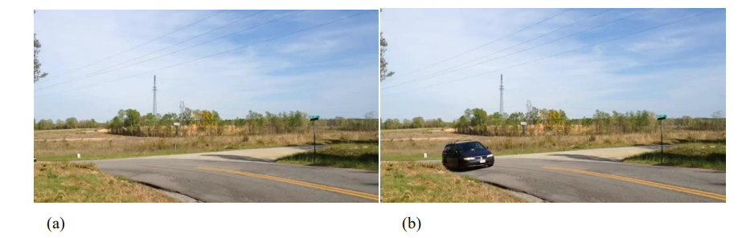
Existing system
CCTV systems (Closed Circuit Television) become usable in several areas of security. CCTV is used mainly for recording daily happenings in a particular place.
Here we can see a basic surveillance camera recording of a car on the road

Slide 7
Proposed system:
The main goal of our mini-project is to provide solutions that detect moving objects with certain geometry in real time.
In our project, we seek to propose a method which can reduce the effect of the challenges described above and can run a fairly effective and efficient manner in terms of results and response time.
These were done by writing an efficient code in python using OpenCV.

Slide 8
PROBLEM STATEMENT:
The video surveillance is one of essential techniques for automatic video analysis to extract crucial information or relevant scenes in video surveillance systems.
The aim of our work is to propose solutions for the automatic detection of moving objects in real time with a surveillance camera.
The detected objects are objects that have some geometric shape (circle, ellipse, square, and rectangle).
This work is in the field of video surveillance including motion detection.

Slide 9
DEVELOPMENT ENVIRONMENT
HARDWARE REQUIREMENTS
PROCESSOR: | Minimum 1Ghz
RAM: | 2 GB and above
HARD DISK: | 32 GB and above
SOFTWARE REQUIREMENTS
OPERATING SYSTEM: | Windows 11.
PLATFORM: | PYTHON IDE
LIBRARIES: | OpenCV

Slide 10
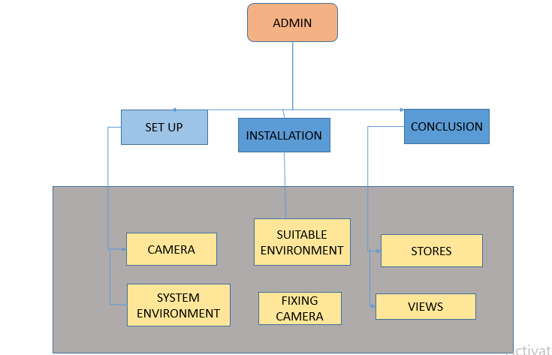
SYSTEM ARCHITECTURE:

Slide 11
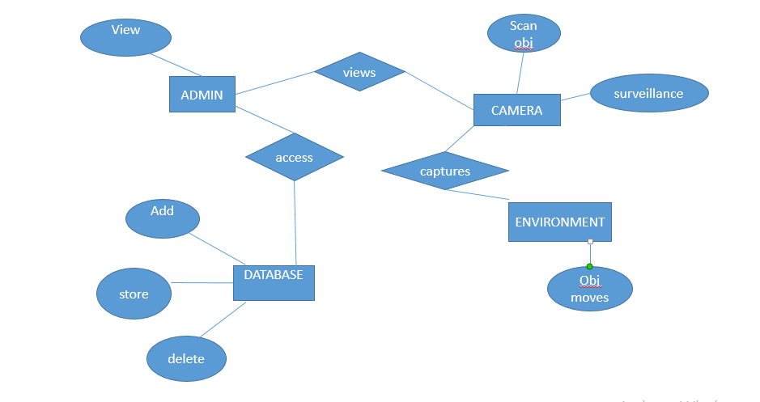
SYSTEM DESIGN: ER DIAGRAM:

Slide 12
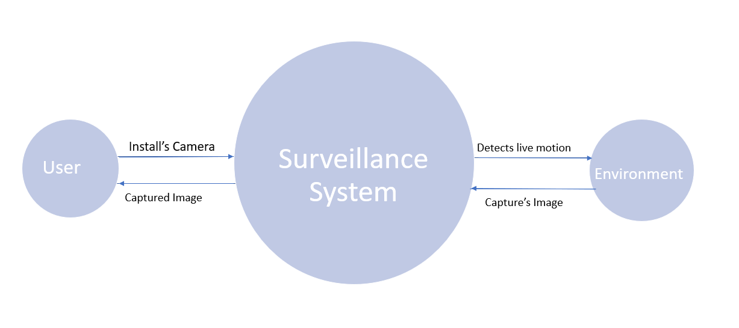
Dataflow diagram:
DATAFLOW DIAGRAM LEVEL 0

Slide 13
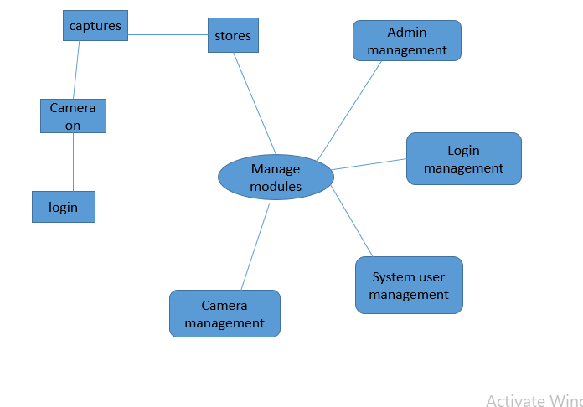
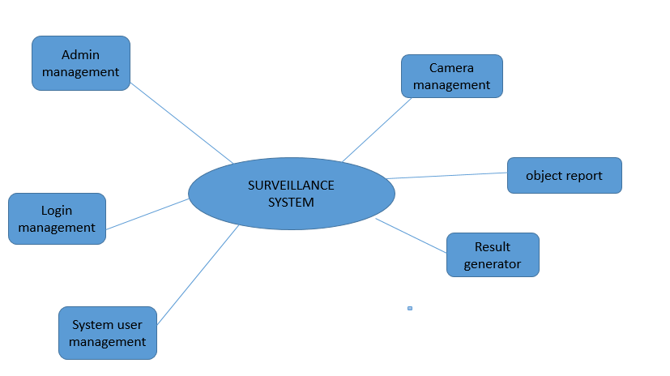
DATAFLOW DIAGRAM LEVEL 1
DATAFLOW DIAGRAM LEVEL 2

Slide 14
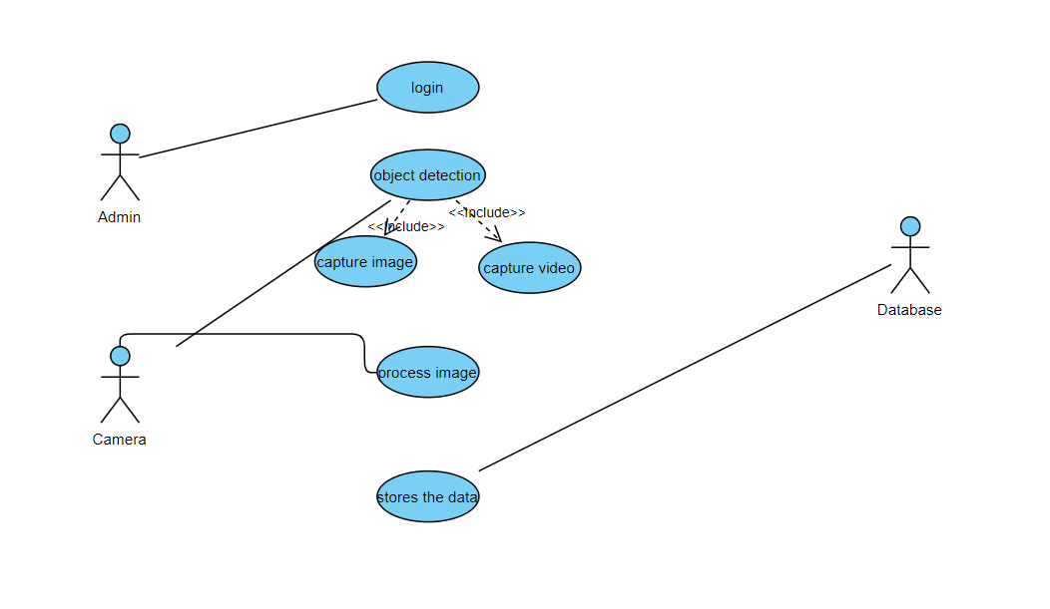
Use case diagram

Slide 15
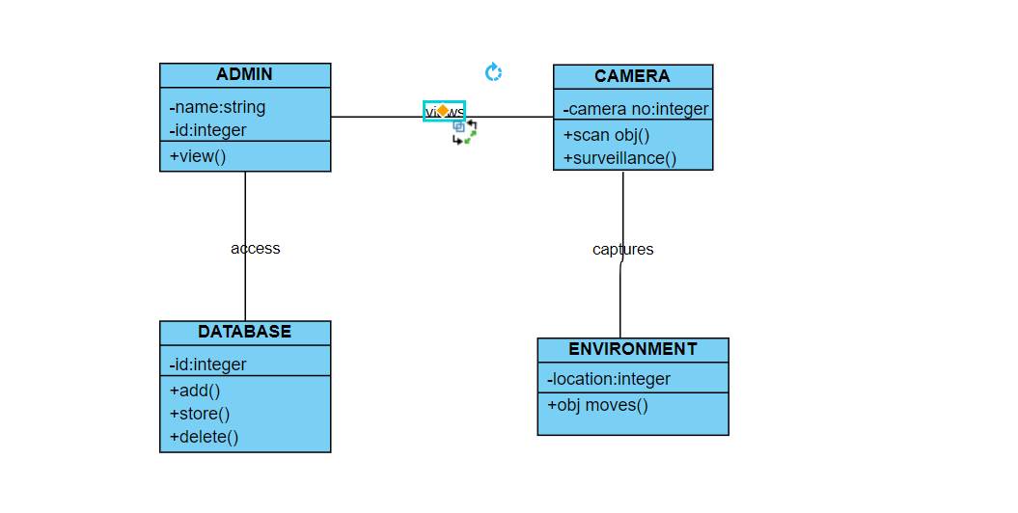
Class diagram

Slide 16
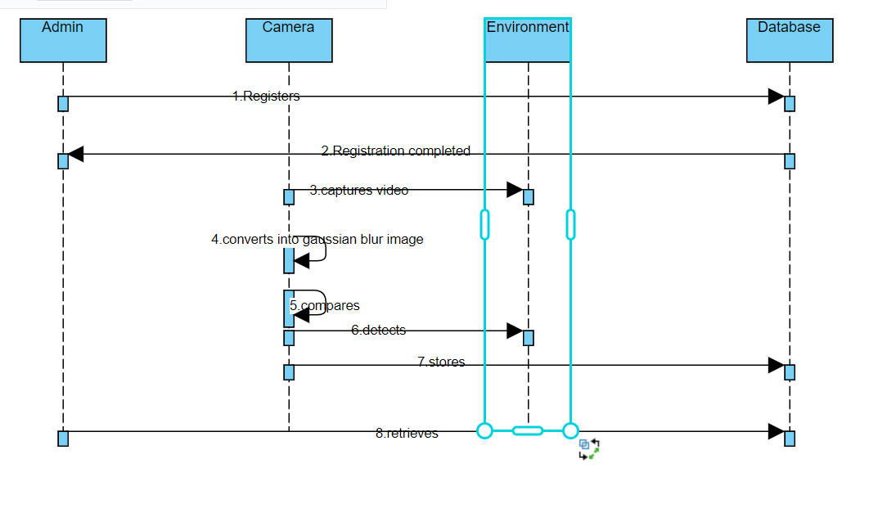
Sequence diagram

Slide 17
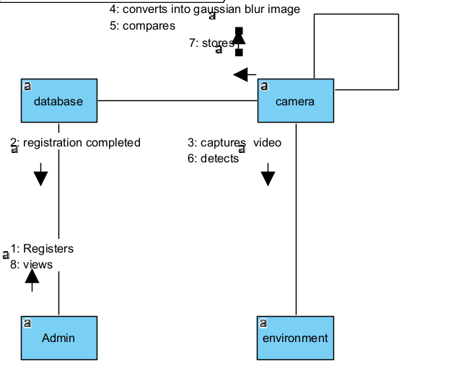
Collaboration diagram

Slide 18
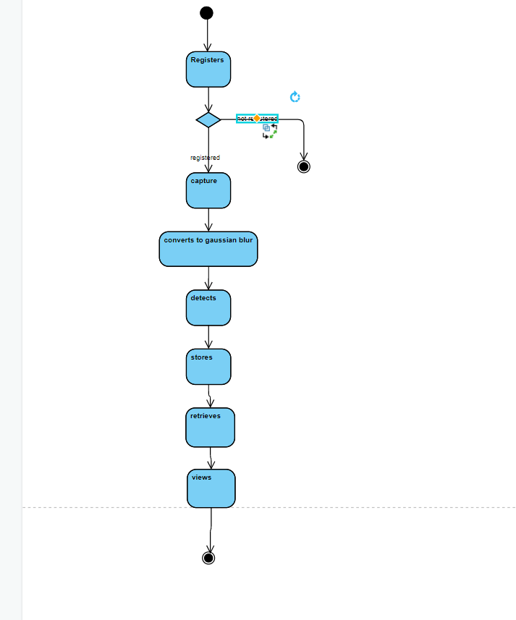
Activity diagram

Slide 19
MODULE DESCRIPTION
Detection module:
Observe the static environment.
Detect the moving object.
Displays the time and date.
Process the image.
Saves the image.
Storage module:
Processed image is stored in local storage.
Can be viewed by the user.

Slide 20
TESTING: SYSTEM TESTING:
TEST CASE ID | TESTCASE/ACTION TO BE PERFORMED | EXPECTED RESULT | ACTUAL RESULT | PASS/ FAIL
1 | Setting up System Environment | Opens required Python IDLE | Opens required Python IDLE | Pass
2 | Installing OpenCV | OpenCV Installed | Successful installation of OpenCV | Pass
3 | Developing the code | Code with no error | Code with no Indentation error | Pass
4 | Setting up the path to store data | Storage of required data | Successful storage of data | Pass
5 | Implementing the code | Opening of Camera App | Opening of live camera | Pass

Slide 21
TEST CASE ID | TESTCASE/ACTION TO BE PERFORMED | EXPECTED RESULT | ACTUAL RESULT | PASS/ FAIL
6 | Selecting the run button | Opens the Camera App | Live camera app opens | Pass
7 | Viewing the camera | Detection of live motion | Detects the live motion | Pass
8 | Observing the camera | Displays occupied/unoccupied with date and time | Displays occupied/ unoccupied with date and time | Pass
9 | On moving in front of camera | Camera capture the moving object | Camera capture the moving object | Pass
10 | Viewing the local storage for data | Storage of captured data | Storage of captured image | Pass

Slide 22
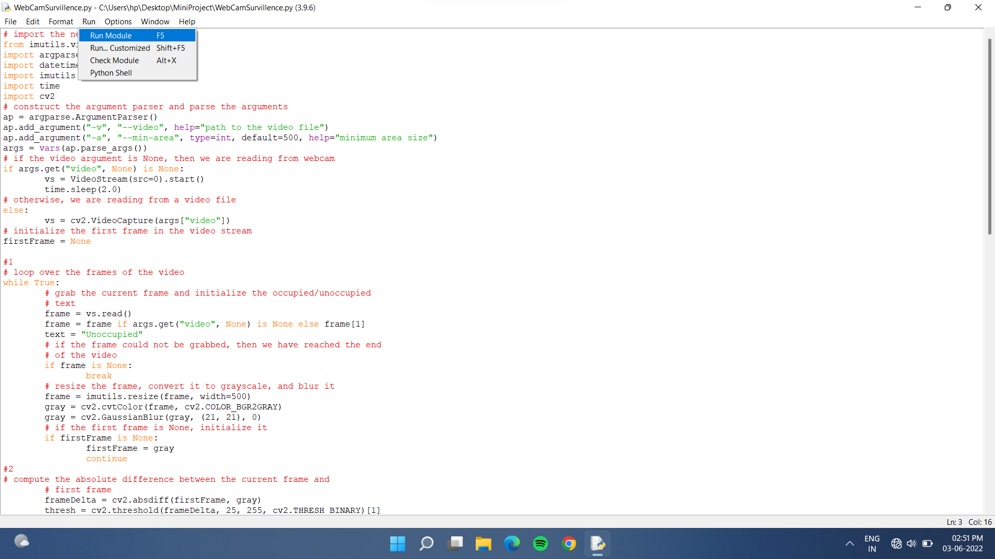
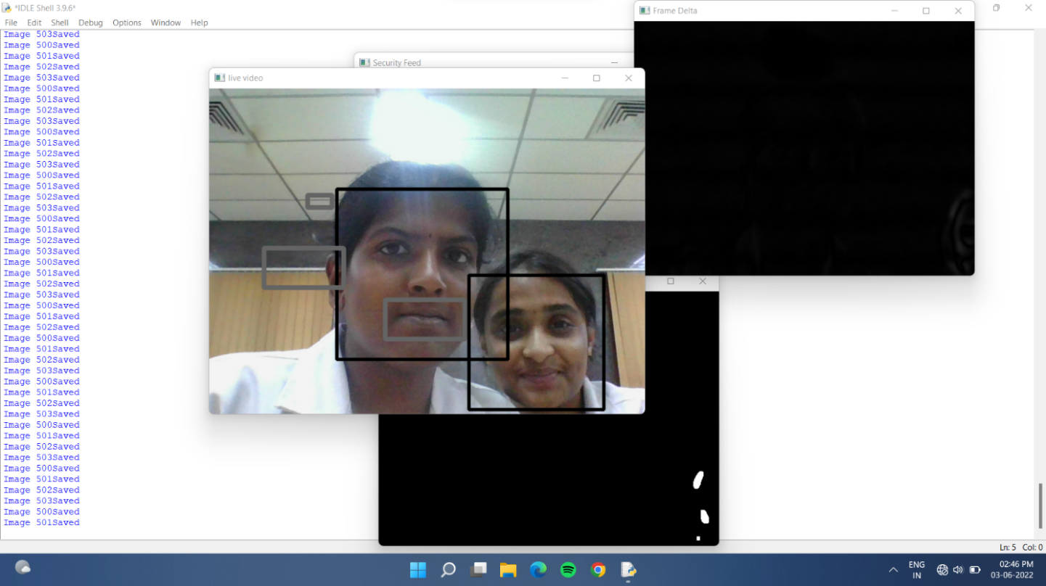
SCREENSHOTS:
Coding part of the motion detection based surveillance system where the user is clicking run button.
Output window of the motion detection based surveillance system where the users face is detected.

Slide 23
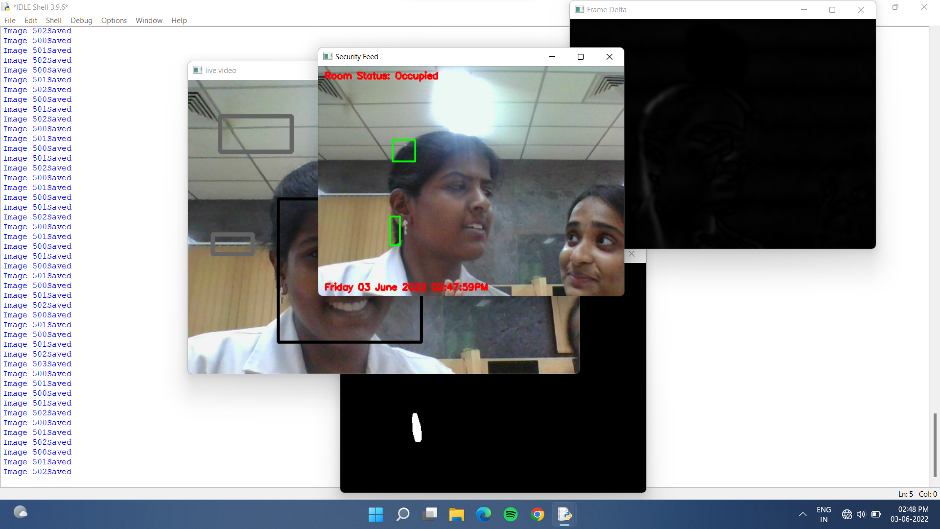
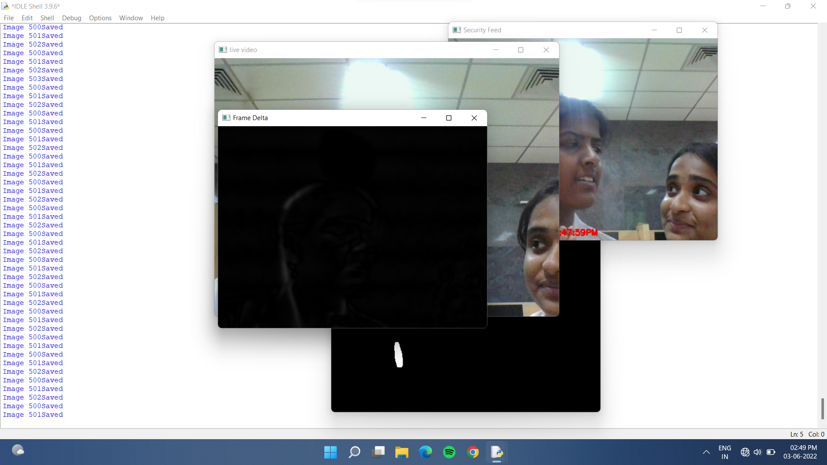
Output window of the motion detection based surveillance system where the frame delta window is shown.
Output window of the motion detection based surveillance system where the user’s room status and time is shown.

Slide 24
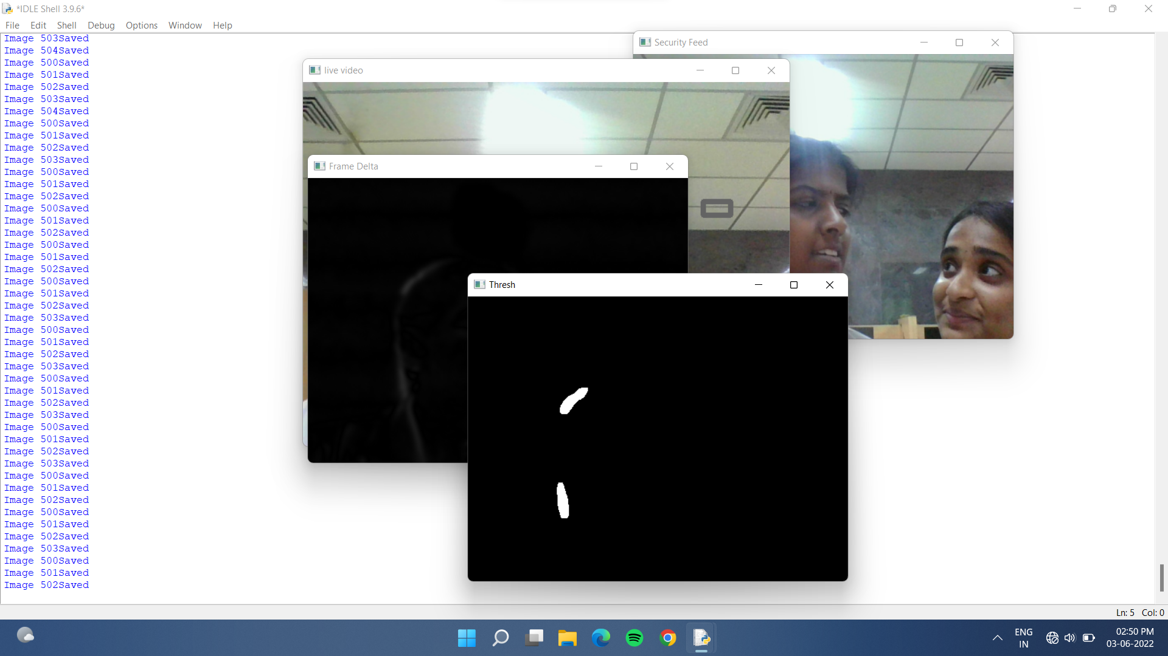
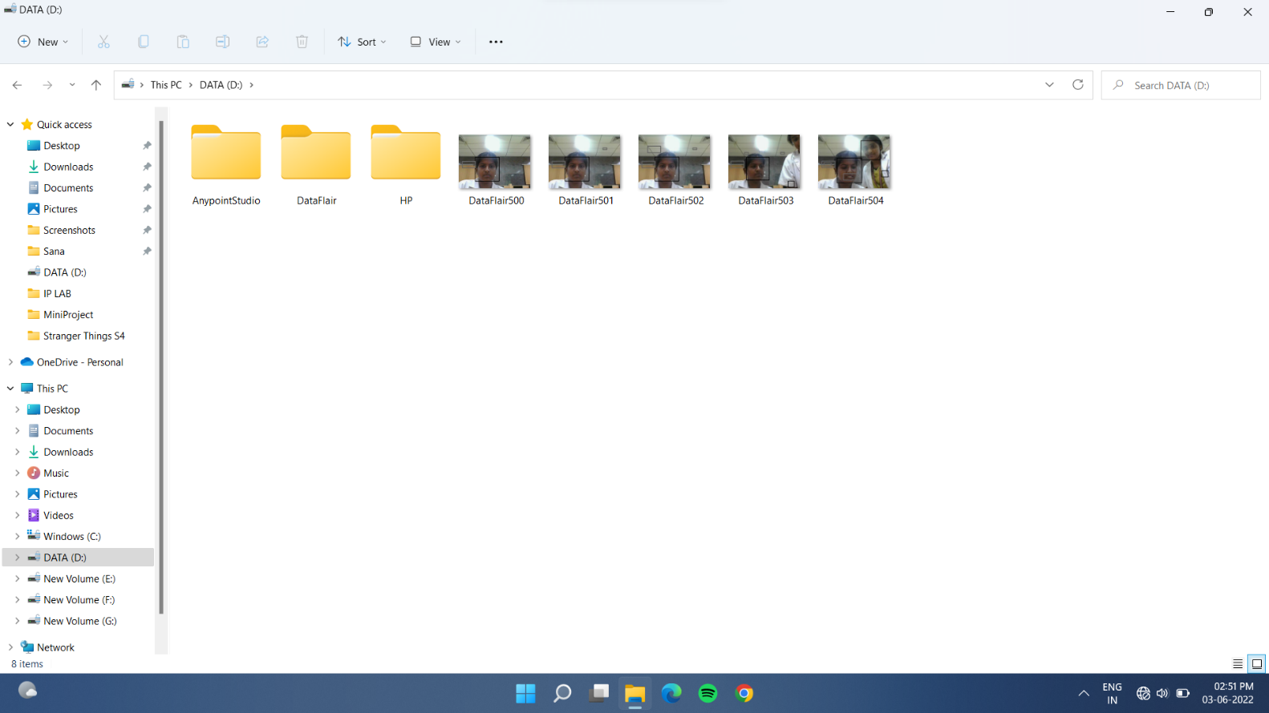
Output window of the motion detection based surveillance system where the location of captured image is shown.
Output window of the motion detection based surveillance system where the thresh window is shown.

Slide 25
conclusion
Motion Detection Based Surveillance System helps people to make their job much easier. The application presented in this mini project is a proof of concept on how to create an application that can detect human motion in an environment, which also uploads images to a local storage. The application also needs an internet connection and a local drive storage in order to upload images to the local storage. The application is suitable in an environment which is static and the movement that occurs is caused by human movement, for example a conference room. The application’s motion detection has its limits, for example the application can not tell the difference between moving objects and human movement.

Slide 26
References
)Singh, B., Singh, D., Singh, G., Sharma, N., & Sibbal, V. "Motion detection for video surveillance" 2014 International Conference on Signal Propagation and Computer Technology,pp:193-197,(2014)
)Zarka, N., Alhalah, Z., & Deeb, R.," Real-Time Human Motion Detection and Tracking". 3rd International Conference on Information and Communication Technologies: From Theory to Applications, pp:578-583,(2008)
)Tao Jianguo, Yu Changhong, "Real-Time Detection and Tracking of Moving Object," Intelligent Information Technology Application, 2008. UTA '08. Second International Symposium on Volume 2, 20-22 Dec. 2008 Page(s):860 – 863

Slide 27
)Dewan, P.,Kumar, R. "Detection of object in motion using improvised background subtraction algorithm" International Conference on trends in Electronics and Informatics(ICEI),pp:651-656,(2017)
)Jichan Lee, Sungsoo Lim, Jun-Geon Kim, Bomin Kim "Moving Object Detection Using Background Subtraction and Motion Depth Detection in Depth Image Sequences " IEEE international symposium on consumer electronics,pp:1-2,(2014)
)Zhang, L., & Liang, Y. "Motion Human Detection Based on Background Subtraction" Second International Workshop on Education Technology and Computer Science.
,pp:284-287,(2010)

